Slide 1
Strain Mapping of Twisted Bilayer Graphene
Madeline Van Winkle and Nathanael Kazmierczak
08/16/2019
National Center for Electron Microscopy

Slide 2
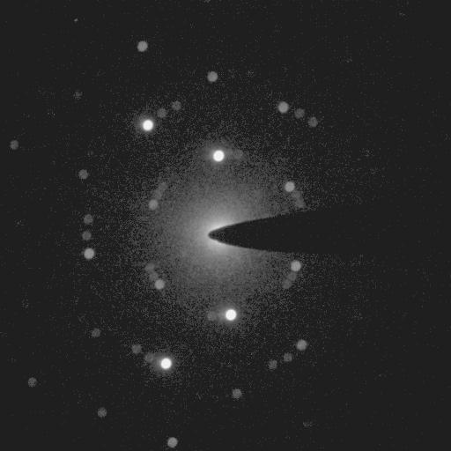
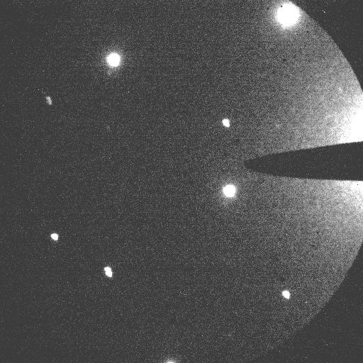
Data Examples (Two Sessions)
6.7º twist angle
1.2º twist angle

Slide 3
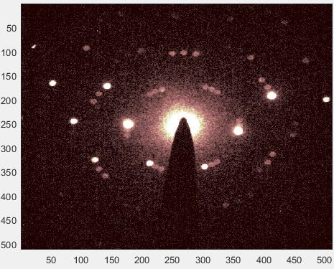
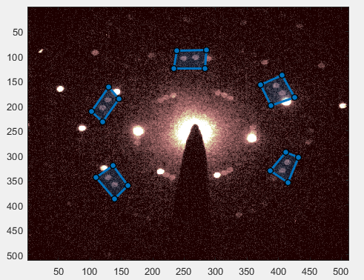
Overview of Analysis
Done mostly in Matlab
Use of region-of-interest image processing to separately handle the two graphene lattices, eliminate hexagonal boron nitride peaks
Conceptually the same as py4DSTEM, occasionally calls the Python code itself
Draw Polygons

Slide 4
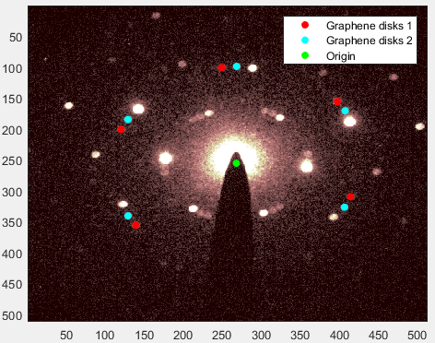
Sort Graphene Layers
Peaks sorted by polar coordinates angle from the origin
“Origin” found from center of mass of all disk positions except the topmost two

Slide 5
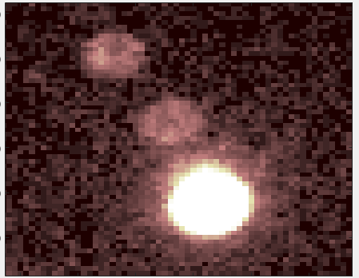
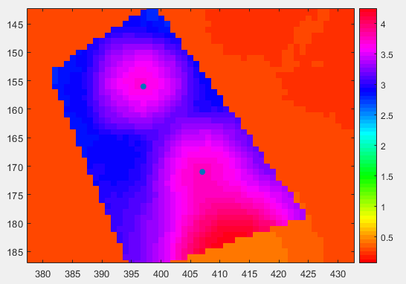
Disk Registration
Using cross-correlation
Synthetic kernels (flat disk with radius = 5 pixels)
Vacuum probe measurement has not worked (beam too big?)

Slide 6
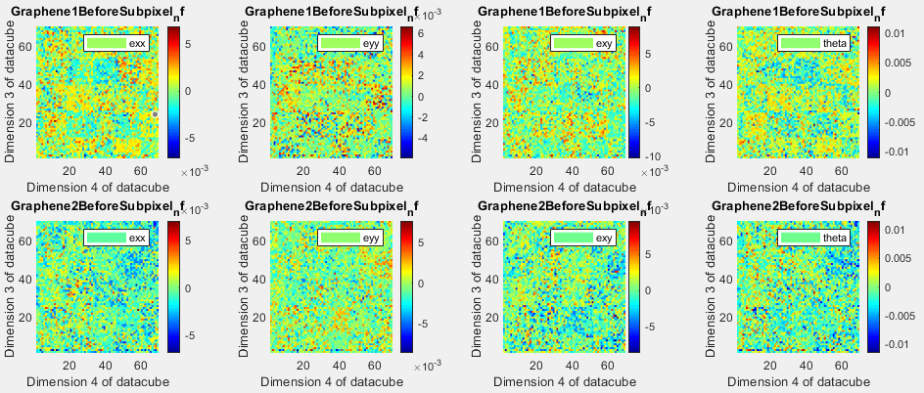
6.7º Twist Angle, No Subpixel Detection
Notes:
Unfiltered here referring to only plotting things on a certain interval on the z-axis.

Slide 7
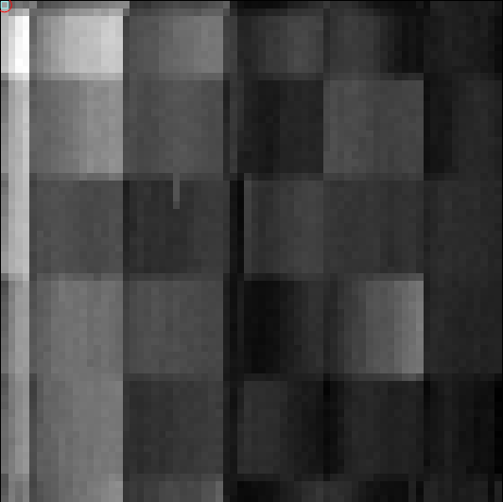
6.7º Twist Angle Real Space Image From py4DSTEM
What does this represent?
Similar square pattern to the no-subpixel strain maps

Slide 8
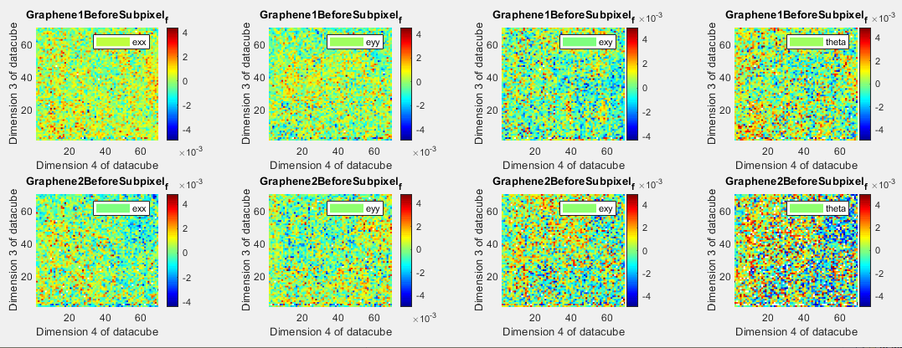
6.7º Twist Angle, Parabolic Subpixel Detection
Square-like structure seems to go away with better disk registration algorithm.
Notes:
Unfiltered here referring to only plotting things on a certain interval on the z-axis. Filtered means that I have constrained the colormap axis to be between -0.005 and 0.005. The reason that the theta map is a lot more choppy is because it tends to have a larger variance than the other elements of the strain tensor, and some of them get cut off when we restrict the range like this.

Slide 9
(Maddie’s stuff goes in here)
Do you have a generic introductory slide talking about atomic reconstruction in twisted bilayer graphene and generally what it is we are trying to do? My slides launch right into the data analysis.
Another thing you could perhaps do is have an image with measurement of the vacuum probe, since we are confused as to how that is supposed to work for convolutions given that it seems to be of a different size.

Slide 10
The following are extra slides that we will only use if zooming in / determination of the central beam position come up in our conversation

Slide 11
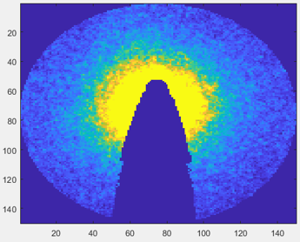
Masking
Draw polygon mask to cut out beamstop, avoid inner Bragg disk ring
Dark blue has been cut out
Same method as defining polygon regions for Bragg disk detection

Slide 12
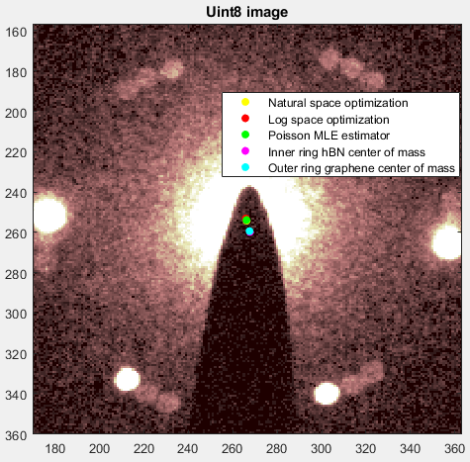
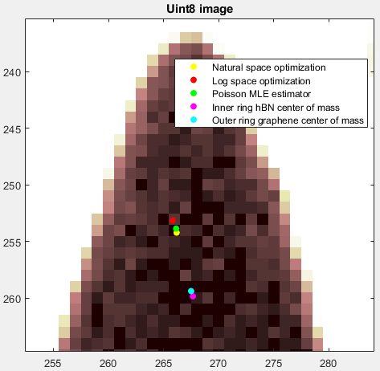
Center of Mass and Power Law Fits Do Not Agree
Each seems to be doing exactly what it was designed to do.

Slide 13
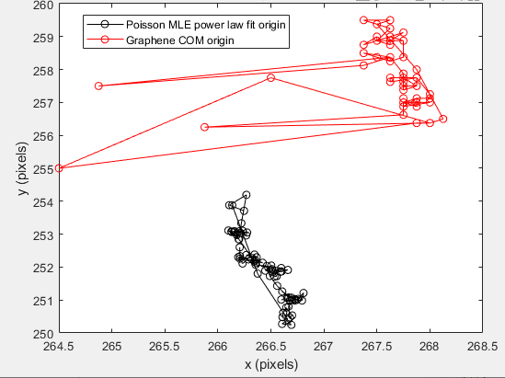
COM/Power Law Offset Seems Consistent
Wild red points occur when graphene disks were mis-detected
Problem has since been corrected
Disagreement is by 6 pixels in y, 1 pixel in x
70 diffraction patterns represented

Slide 14
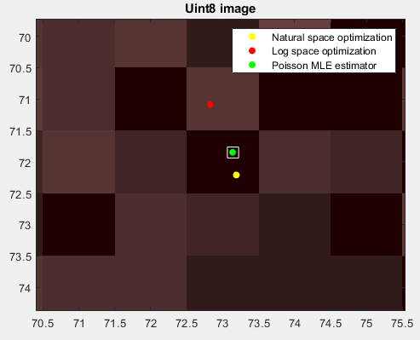
Poisson MLE Robust Against Noise
30 fold bootstrap of Poisson MLE coordinates conducted
Range of origin coordinates given by white box
Interpretation: the random noise in the data set does not hamper the power law fit
Beamstop distortions may still be an issue

